Slide 1

Creating a fire alarm using household IOT sensors
Gabi Rivera, Sahil Wadhwa, and Liam Richardson

Slide 2
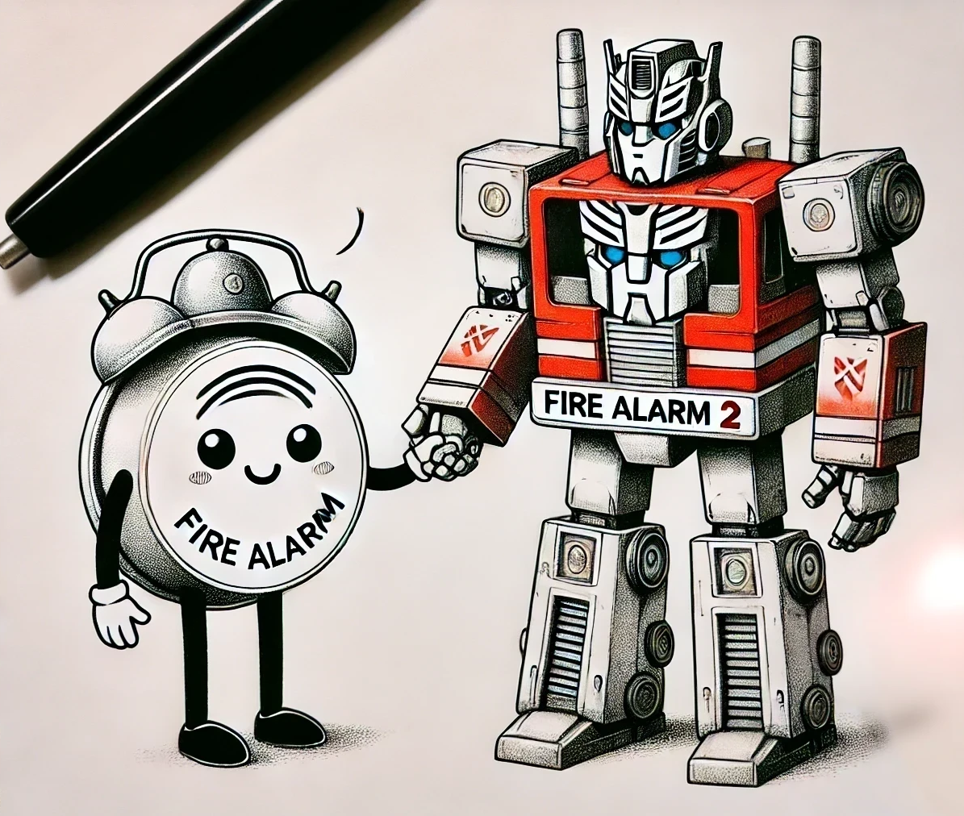
Introduction
Fire alarms save lives, but their efficacy is stifled by false alarms and hardware issues.
It has been noted that by fusing data from common household IOT sensors, one can produce a makeshift fire alarm.
This second fire alarm can be used in conjunction with traditional fire alarms to increase the confidence of a reported fire.

Slide 3
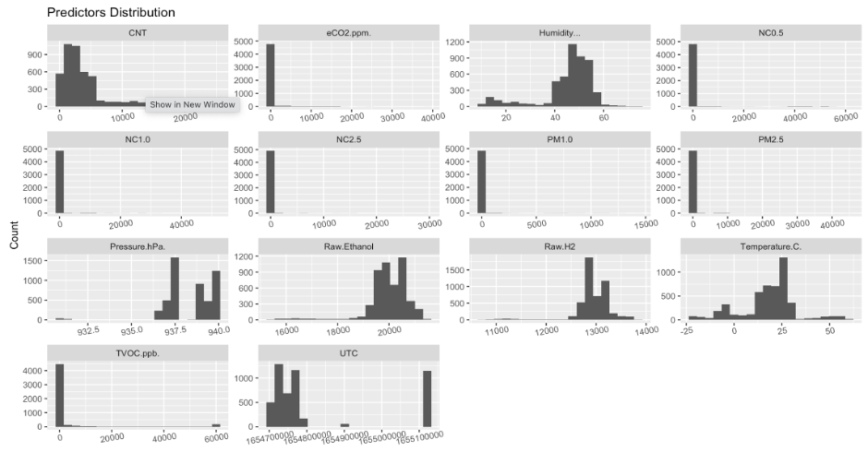
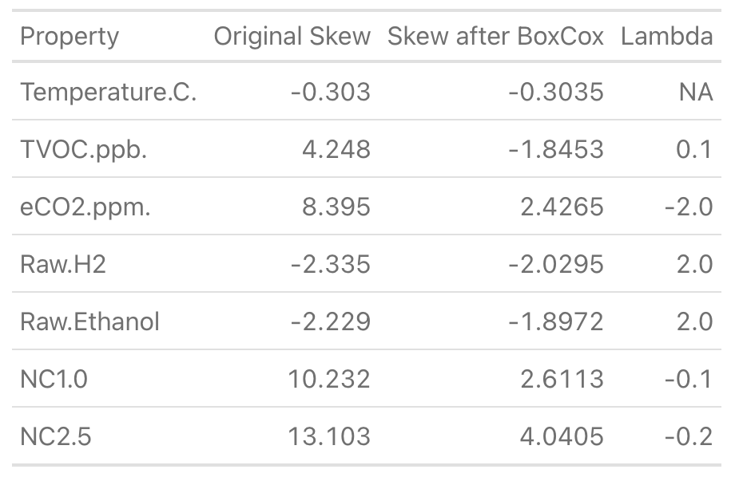
Data Preprocessing
General Data Info
5,000 obs.
14 numerical features
1 binary outcome (Yes and No)
No missing values
Transformations
UTC to hour, day, month, & year format
Predictors with high Pearson Correlation Score >0.75 were removed reducing predictors to 7 variables
No predictor with <0.5 skewness score after Box-Cox Transformation
Center & Scale was performed before running the predictors into the models
Data Splitting
80% Train set and 20% Test set
Train set rebalanced (ROSE)

Slide 4
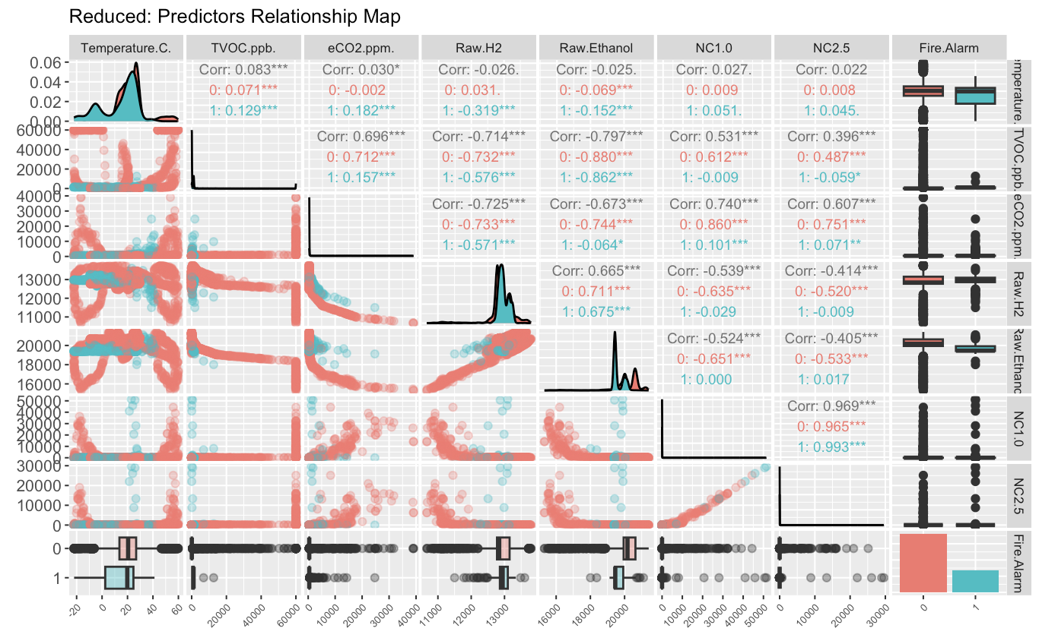
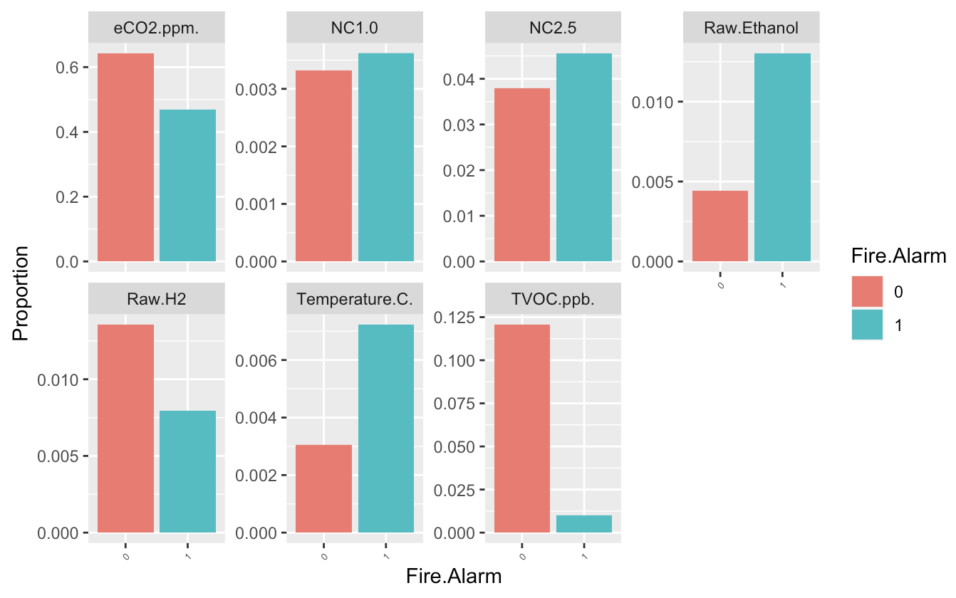
Exploratory Data Analysis
*NC (Concentration of Particulate)
*TVOC (Total Volatile Organic Compounds)
*eCO2 (CO2 equivalent)

Slide 5
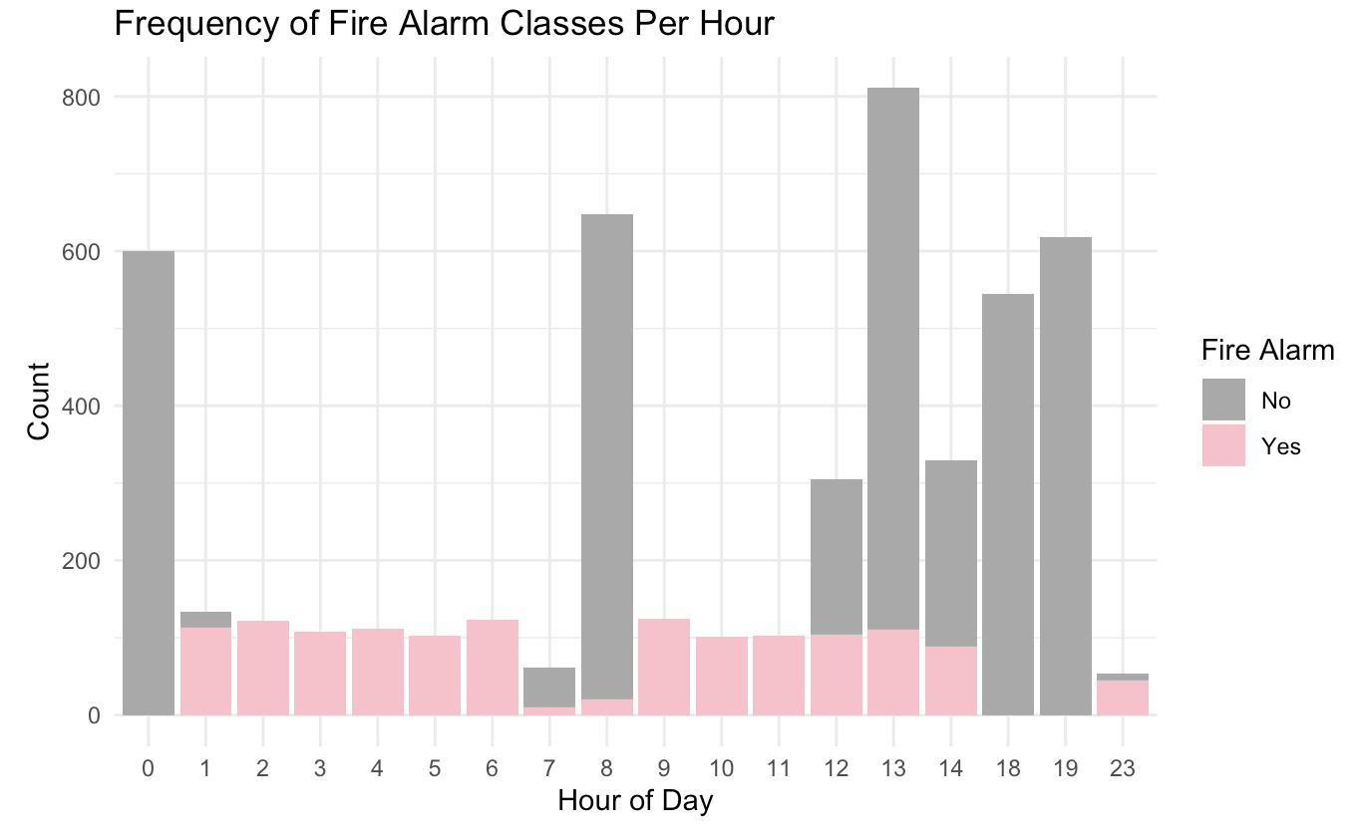
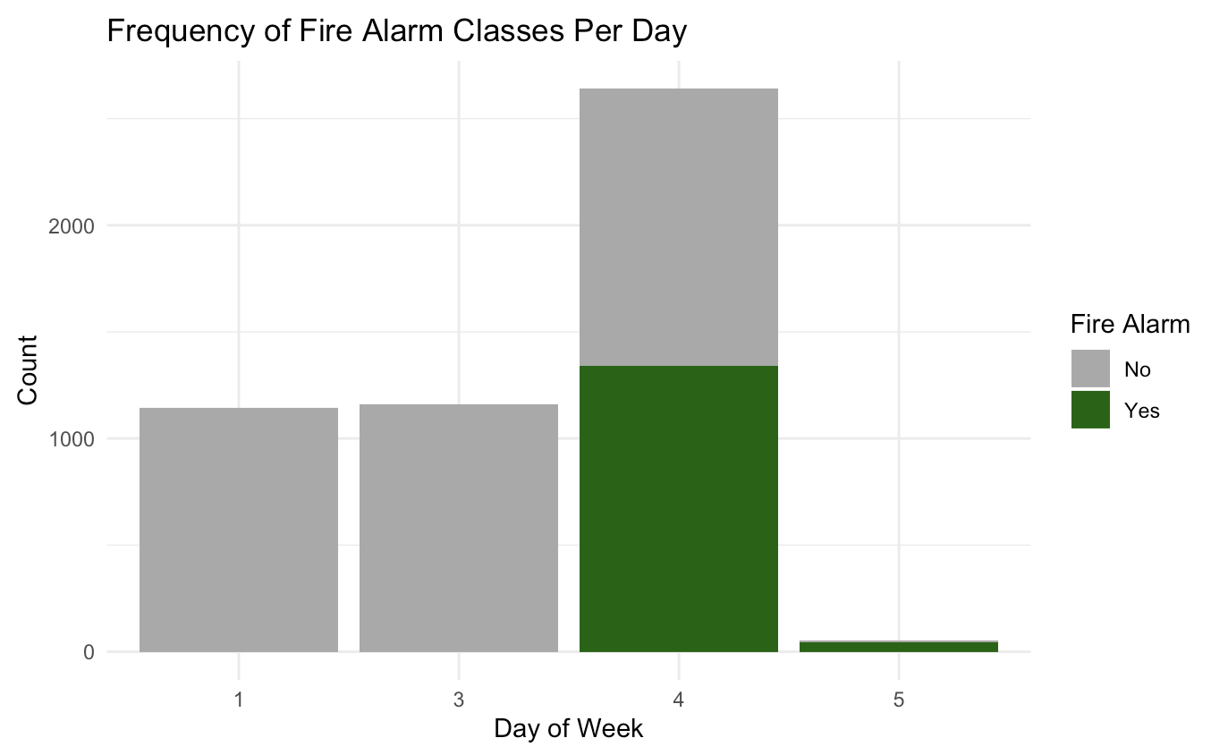
Exploratory Data Analysis

Slide 6
Model Strategies
As a fire alarm is essentially a binary classification problem, we opted for models which are intended for classification
Of these: KNN, NSC and Logistic Regression are explicitly designed for classification. For the other models the following adjustments were made
The Neural Net was adjusted to use a softmax activation function + a cross entropy loss function to be appropriate for classification.
A radial basis function was selected for the SVM.
Fire alarm was set as a factor to indicate to the MARS model that this is a regression task.

Slide 7
Model Tuning
Model Name | Tuned Hyperparameters | Optimal Value
Logistic Regression | N/A | N/A
NSC | shrinkage | 11
SVM | cost,sigma
Neural Net | Hidden layer width,depth, learning rate | 8 hidden layer neurons, 1 hidden layer, lr=.01
MARS | Number of features | 11
KNN | Number of neighbors | 1

Slide 8
Performance Evaluation and Conclusion

Slide 9
References

